Slide 1


Medical
Appointment
No-Show Prediction
Devadharshini Radhakrishnan

Slide 2


Introduction
No-Show challenge in Healthcare
Missed medical appointments are one of the biggest operational and financial burdens in modern healthcare
  Globally, 23 - 30% of outpatient appointments are missed
  Consequences:
- Wasted clinician time and equipment
- Longer waiting lists for other patients
- Disrupted continuity of care
- Revenue loss and inefficient resource allocation

Slide 3


Project Goal
Predict the probability of a patient missing their appointments
Enable proactive interventions ( SMS reminders, Overbooking Strategy, Phone Calls)
TARGET : Identify high-risk patients (>=70% probability) with high precision

Slide 4


Dataset Overview
Dataset from : https://data.mendeley.com/
  Real medical appointment records ( Brazil Region)
  Size: 49,593 Appointments
  Time Period: 2020 - 2022
KEY FEATURES:
  Patient: Age, Gender, Disability, City, Needs Companion
  Appointment: Specialty, Shift (Morning/afternoon)
  Weather: Temperature, Rain intensity, Heat intensity
  Temporal: Appointment date, Entry service date, Day of week

Slide 5


Target Distribution
  Show = ~88-90% | No-Show : ~ 10-12%
  Slightly imbalanced → used F1-Score as primary metrics
Goal: Reduce no-show rates by 20–40%, save costs, and improve patient care – all with a ready-to-deploy tool.

Slide 6

Project Workflow
PROBLEM IDENTIFICATION
  High no-show causes revenue loss and inefficiency in the clinics
DATA COLLECTION
  Raw dataset: Medical appointment no show.csv file with 49k real appointments from Brazilian rehabilitation/ psych clinics
DATA CLEANING & EXPLORATION
  Handle missing values & outliers
  Convert dates and remove noise columns
  Fix inconsistent categories

Slide 7
Project Workflow
FEATURE ENGINEERING
  Created powerful predictors :
  Days in advance ( appointment_date - entry_service_date) → strongest feature
  Appointment month, day of week, year
  Demographic ( Birth year, Age, Gender)
  Weather features (rain_intensity, heat_intensity, rain_day_before, etc.,)
DATA PREPROCESSING
  Using LabelEncoder to convert the continuous categorical values into numerical values
  Split the dataset into a train set and a test set with the help of train_test_split
  MinMaxScaler to give the value from 0 to 1 for x_train and x_test

Slide 8
Project Workflow
MODEL USED
FROM SCIKIT-LEARN
  LINEAR_MODEL
  LogisticRegression (Linear - Baseline model)
  ENSEMBLE
  GradientBoostingClassifier (Ensemble - Boosting)
  ExtraTreeClassifier (Ensemble - Extreme Bagging)
  RandomForestClassifier (Ensemble - Bagging)
  AdaBoost Classifier (Boosting)
  NEIGHBORS
  KNeighborsClassifier (Instance-Based)
  CatBoostClassifier (Gradient Boosting for categorical)
  XGBoostClassifier (Optimized Gradient Boosting)

Slide 9
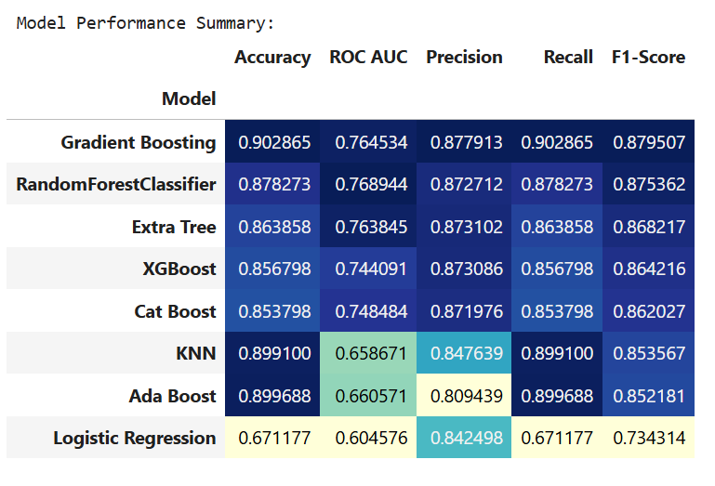
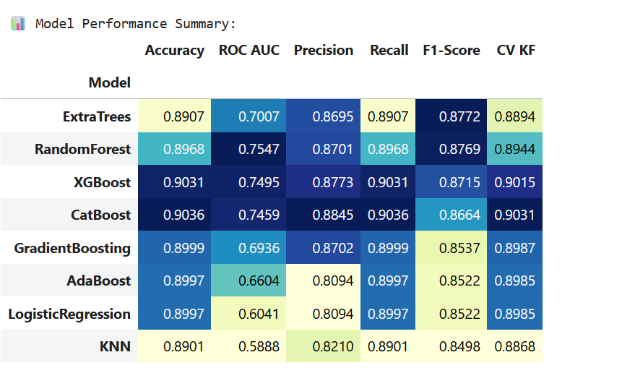
Project Workflow
HYPERPARAMETER TUNING
  RandomizedSearchCV - It often finds better models faster
  from model_selection in scikit-learn
BEFORE TUNING
AFTER TUNING

Slide 10
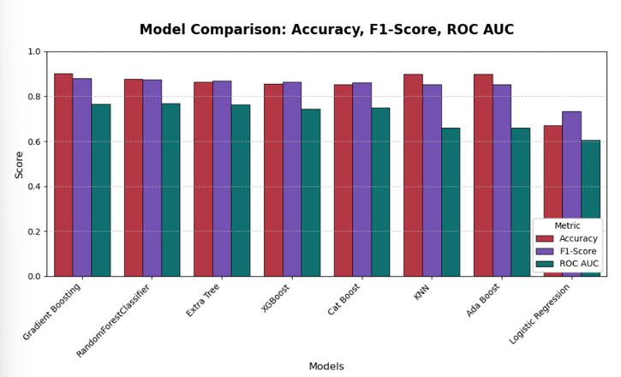
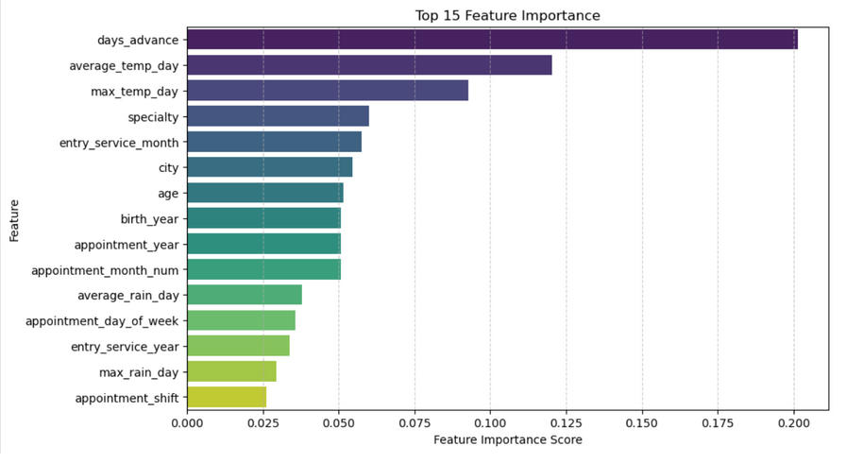
Project Workflow
MODEL AND EVALUATION
  Tested 8 algorithms
  Winner → Gradient Boosting Classifier (n_estimators = 500, max_depth = 7, learning_rate = 0.05, subsample = 0.9)
  Final Metrics on test set: (Accuracy 90.3% | F1-Score 87.95% | ROC-AUC 0.7645)

Slide 11
Project Workflow
MODEL SAVING
  Saved as pkl file using pickle
PREDICTION ON TEST SET + RESULT FILE
  Generate final csv file containing : Actual_no_show | Predicted_Class | Predicted_Prob (for every test appointment)

Slide 12
Project Workflow
DEPLOYMENT - TWO STREAMLIT WEB APPS
  Analytics dashboard
  Overall model performance metrics
  ROC Curve, Probability distribution, Feature Importance
  High-Risk Patients table ( Predicted_prob >=70%)
  Live Prediction Tool
  User enters patient + Appointment _ Weather details
  Instant risk score + Gauge + Recommendation ( Low / Medium / High)

Slide 13
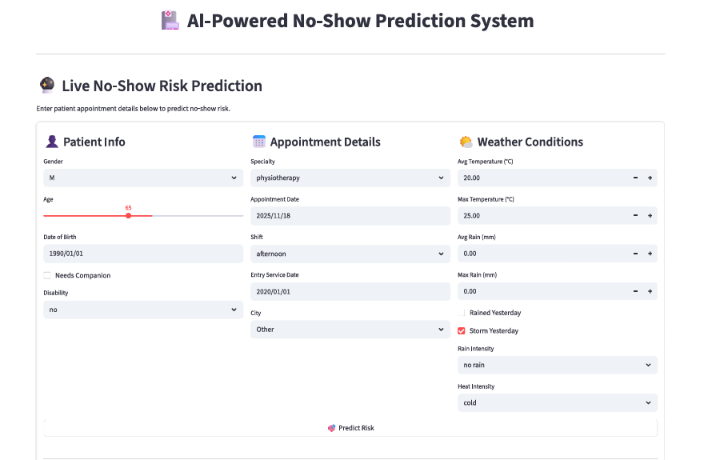
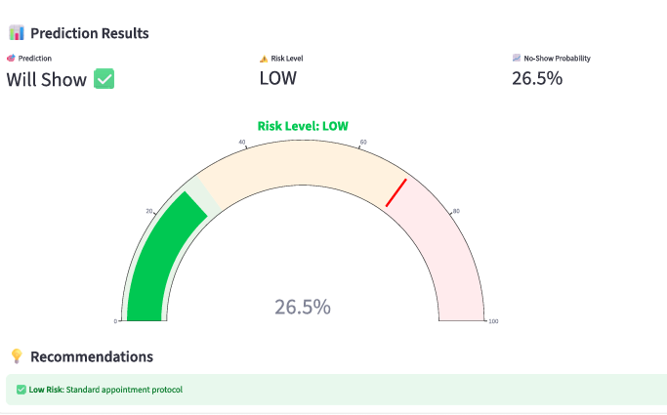
LIVE PREDICTION TOOL
Input patient details → Real-Time risk score
OUTPUT:
  Probability ( e.g., 78%)
  Risk Level: Low/ Medium / High

Slide 14
BUSINESS IMPACT & RECCOMENDATIONS
LEVEL | PROBABILITY | RECOMMENDED ACTION
HIGH | >=70% | CALL + SMS + Confirm Appointment
Medium | 30-69% | Automated SMS/ Whatapp remainder 2 days Before
Low | < 30% | Standard Protocol

Slide 15
FUTURE ENHANCEMENTS
  Integrate with the hospital management system (API)
  Add SMS/WhatsApp automation
  Deploy on cloud (Streamlit Community Cloud / AWS)
  Retrain monthly with new data
  Add patient historical no-show count
CONCLUSION
  Successfully built an accurate, interpretable, and deployable no-show prediction system
  Ready for real-world use in clinics/hospitals
  Proven potential to save time, money, and improve patient care

Slide 16
Thank
You.

